Slide 1
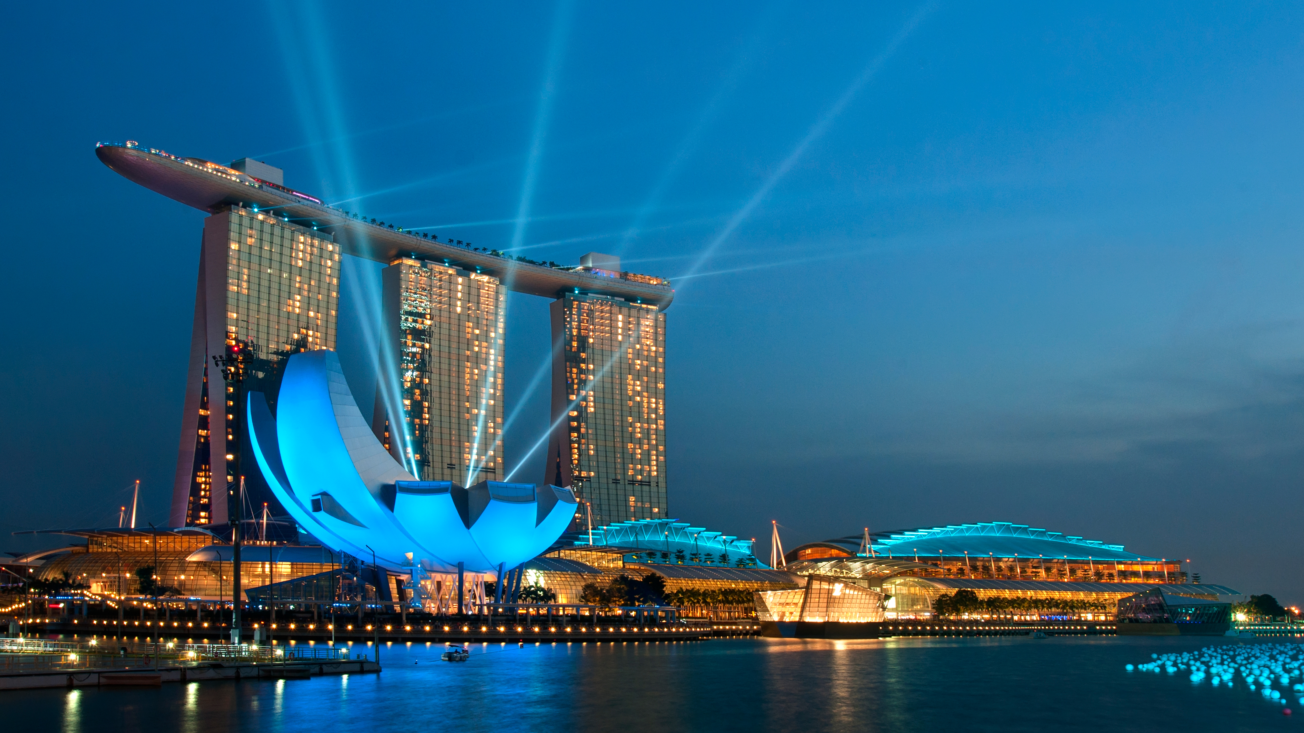
Europe Hotel Satisfaction prediction
Mohamed arafa ezzat

Slide 2
Index
Introduction
Dataset
Questions

Slide 3

intro
A good starting point would be swaying customer feedback towards ‘satisfied’ by understanding which parameters are important to ‘satisfied’ customers and predicting whether will be satisfied or not to give the right treatment.
A satisfied customer is the best business strategy of all " Micheal LeBoeuf: American busniess author.

Slide 4
Dataset
Data contains:
103904 Rows
16 Columns
Features:
Age : 7 to 85
purposeoftravel : aviation, academic, personal, business, tourism.
Type of Travel : Group travel, Personal Travel.
Type Of Booking : Group bookings, Individual/Couple.
Hotel wifi service : Ratings out of 5.
Departure/Arrival convenience : Ratings out of 5.
Ease of Online booking : Ratings out of 5.
Hotel location : Ratings out of 5.
Food and drink : Ratings out of 5.

Slide 5
Dataset
Stay comfort : Ratings out of 5.
Common Room entertainment : Ratings out of 5.
Checkin/Checkout service : Ratings out of 5.
Other service : Ratings out of 5.
Cleanliness : Ratings out of 5.
satisfaction : satisfied, neutral or dissatisfied.
Dataset have :
Missing value problem with column ‘Type Of Booking’
Outliers problem with column ‘Checkin/Checkout service’
Imbalace problem with the target column ‘satisfaction’
Categorical with column ‘Gender’

Slide 6
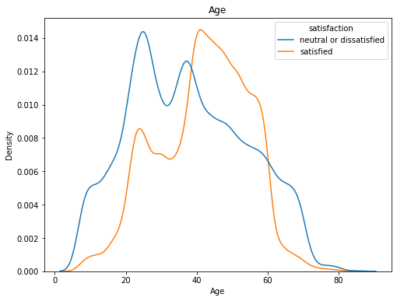
Questions
Q1-What are the ages of customers who are not satisfied with the services provided?
A: the highest level of satisfaction is in the range of 40-60 while under the age of 40 the average level of satisfaction is dissatisfied also over the age of 60 feel dissatisfied.

Slide 7
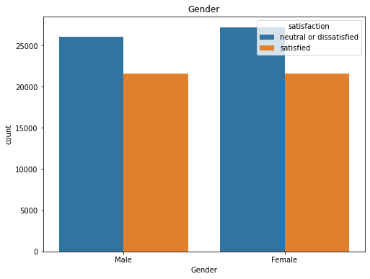
Questions
Q2-What is the gender of customers who are not satisfied with the service?
A: The number of Satisfied and Dissatisfied is almost the same.

Slide 8
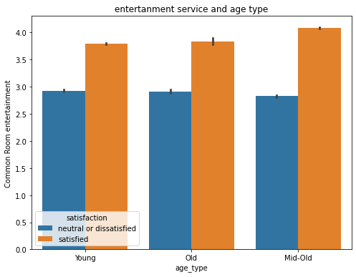
Questions
Q3-what is the most important variable that makes customers satisfied?
A:Food /drink ,comfort, entertainment services the highest score from 3.5 to 4.0 point

Slide 9
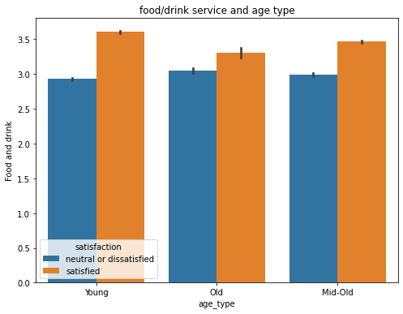
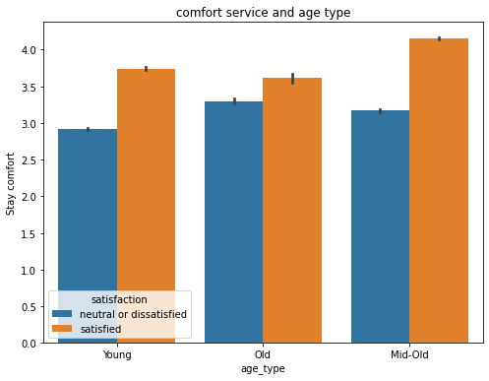
Questions

Slide 10
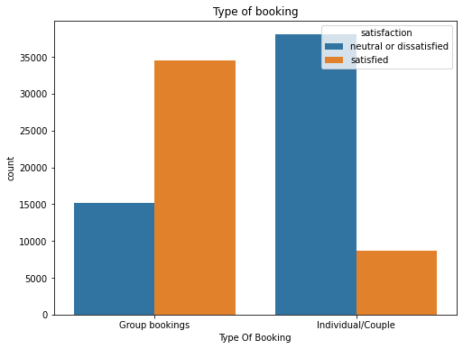
Questions
Q4-Do customers coming with groups give a lower score on the service satisfaction scale?
A:the customer comes personal give a lower score than comes in groups

Slide 11
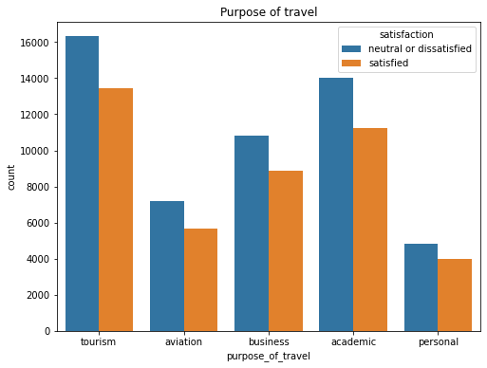
Questions
Q5-Does tourism customer satisfaction increase from business customers?
A:the number of tourism customers satisfied more than business customers.

Slide 12

Thank You

